Slide 1
Pharmacy management system
Presented by Ahmad Bhatti

Slide 2
Contents
Here's a breakdown of the contents and their purposes within the project:
Pharmacy Class
Customer Class
PrescriptionMedicine Class
Main Function

Slide 3
Introduction
Definition of a Pharmacy Management System (PMS) as a digital platform that automates various pharmacy operations.
Importance of PMS in reducing errors, minimizing operating overhead, and enhancing patient safety through automated prescription processing and real-time communication.

Slide 4
Vision and scope
The vision of developing a PMS that combines innovative technologies with traditional pharmacy practices to enhance operational efficiency and patient care.
Scope of the project, including the integration of features like inventory management, e-prescribing, compounding, medication therapy management, and billing solutions.

Slide 5
Objectives of Project
To reduce medication errors and improve patient safety through automated prescription processing and real-time communication.
To streamline administrative tasks and efficiently manage stock levels, facilitating prescription refills and enhancing patient engagement.
To integrate with EHR/EMR systems and third-party platforms like insurance and POS systems for seamless operation and enhanced functionality.

Slide 6
Implementation Tools
Implementation Tools in my program are:
Class inheritance
Polymorphism
Dynamic memory management

Slide 7
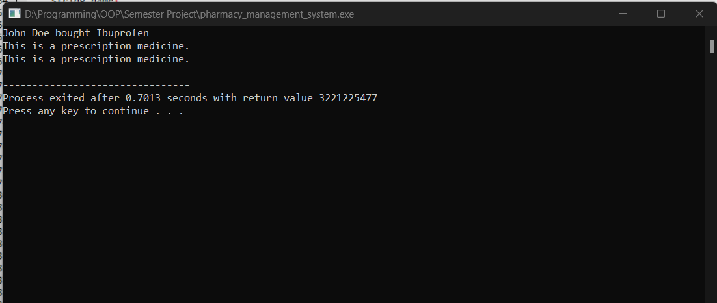

Slide 8
Thanks
.

